Slide 1
Welcome to Year 2
September 2025
Notes:
Welcome parents
- Thank them for coming

Slide 2
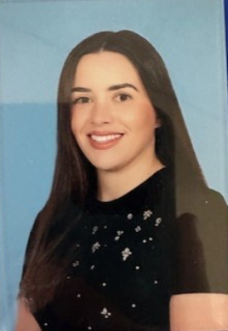
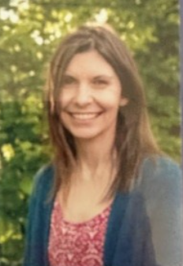
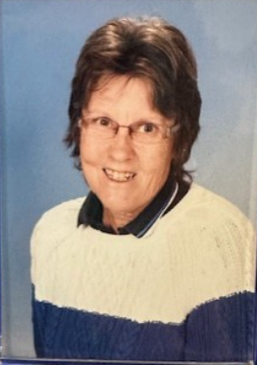
Meet the Year 2 Team
Teaching Staff
Learning Support Team

Slide 3
A few highlights of the year to come….
Autumn
The Rainbow Theatre Company
Fairytale Drama Workshop
Local Walk into Sandhurst
Harvest Church Service
Bonfire Experience
Camberley Pantomime
Christmas fun – Nativity, jumper day, parties and fayre!
Spring
Trip to Rushall Farm
The Great Fire of London
Rebuilding London project
Sculpture and 3D – Clay!
Easter Service at St Michael’s Church
Summer
Trip to The Gilbert White Centre
World Earth Day
Explorers Topic
The Big Day Out
Sewing!
Healthy Wrap making
Summer Fayre
Sports Day and Picnic

Slide 4
What a day in Year 2 looks like…
8:40 Doors open/ Interventions
9:00 Assembly
9:20 Active run
9:25 Phonics
9:45 Maths
10:30 Break
10:45 Handwriting
11:00 English
12:00 Lunchtime
1:00 Guided Reading
1:30-3:00 Foundation Subjects
3:00 Home Time Routine

Slide 5
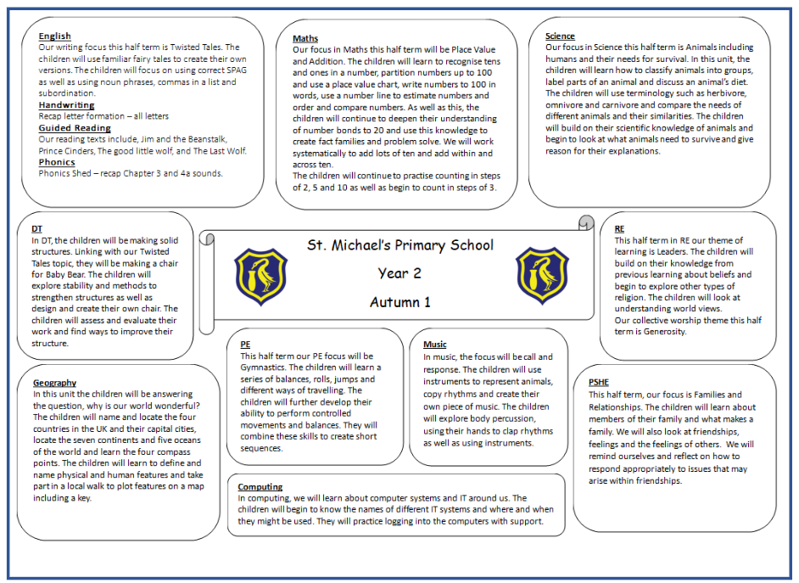
Autumn 1 Topic Web 25/26 - available to take home

Slide 6
Days to remember
PPA day
Monday – Mr O'Keefe and Mrs McComish
PE Days
Monday (Mr O'Keefe) and Wednesday (Mrs Baker)
Reading Books
These can be changed daily. The children will be
encouraged to do this themselves.
Library
Friday afternoon

Slide 7
Phonics and Reading
Phonics
- Daily phonics.
Focusing on spelling, alternative spellings and implementing these into our writing
Reading
Children will be heard read a minimum of once a week.
Children will bring a home reading book that matches their phonic level and keep that book until they have read it. Once they have completed their reading book, they can change it for another. Children will be encouraged to do this independently.
Every read – colour in a star. Every 30 reads, the children will receive a certificate in our Friday celebration assemblies.

Slide 8
Rounding up…
Home Learning
Reading x5 week
Spellings every other week – these will be in reading diaries.
Once a term/half term project – creating, building, researching.
Updates
Our class page will be regularly updated. Keep a look out for learning,
pictures and dates.
Parent Helpers
We always welcome parent helpers. If you would like to help
out in your child’s class, please speak with Mrs Squires in the
school office.
Any Questions?

